Slide 1
Building Solutions With The Microsoft Dial
Daren May
@darenmay
www.CustomMayd.com

Slide 2
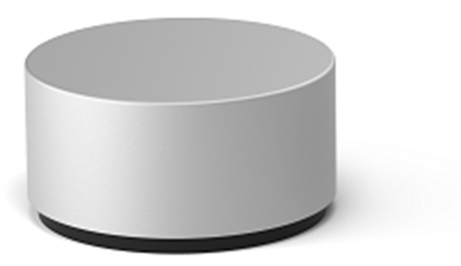
Interactions
Push and Hold
Click
Rotate it!
Place on Screen

Slide 3
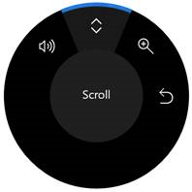
Push and Hold – Off Screen Menu
public bool IsMenuSuppressed { get; set; }
public event TypedEventHandler
ButtonHolding<RadialController, RadialControllerButtonHoldingEventArgs>

Slide 4
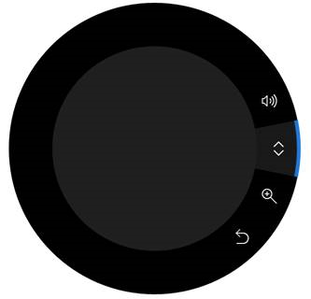

Push and Hold – On Screen Menu

Slide 5
Click
Think of it as left-mouse click
Recommendation – action must be reversible

Slide 6



Customizing the Menu - Icons
Provide a high-quality 64 x 64 pixel PNG image (44 x 44 is the smallest supported)
Ensure the background is transparent
The icon should fill most of the image
A white icon should have a black outline to be visible in high contrast mode

Slide 7

Mapping Rotation to Direction
Clockwise
Counter-Clockwise
Horizontal - Right
Vertical - Up
Depth (Z) - In
Horizontal - Left
Vertical - Down
Depth (Z) - Out

Slide 8
Haptic Feedback
Feel a click every 5 degrees of rotation
Customize - RadialController.RotationResolutionInDegrees
Disable - RadialController.UseAutomaticHapticFeedback
Recommendation – disable if degrees < 5

Slide 9
Demo!

Slide 10
Resources
https://docs.microsoft.com/en-us/uwp/api/Windows.UI.Input.RadialController
https://docs.microsoft.com/en-us/windows/uwp/input-and-devices/windows-wheel-interactions
Source: https://github.com/darenm/SVCC-SimpleSurfaceDialDemo

